Slide 1
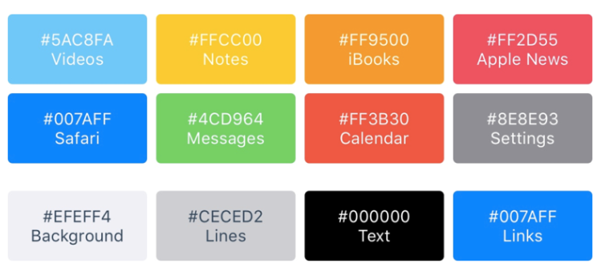
Color for iOS Apple

Slide 2
Font
Helvetica Neue
San Francisco

